Slide 1
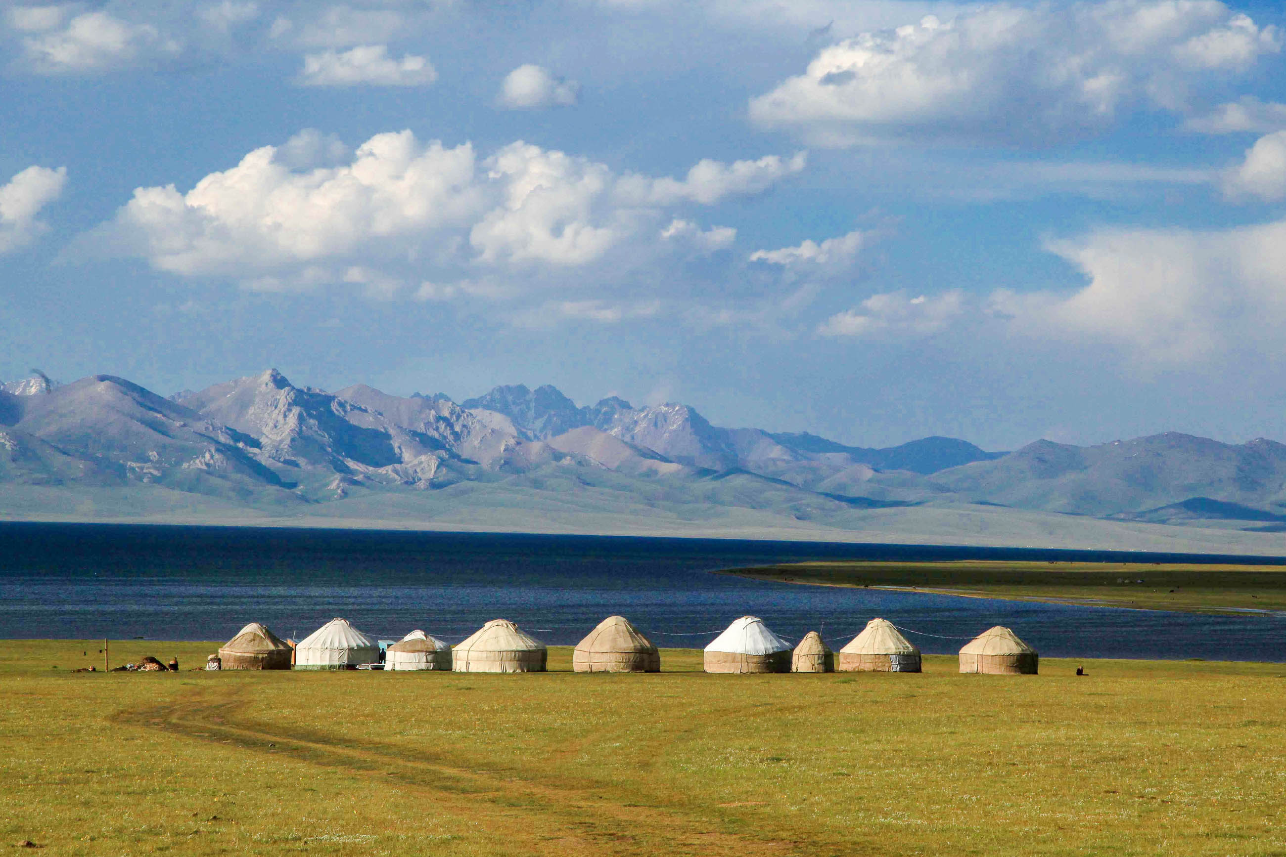



POSSIBILITIES FOR AN ECONOMIC PARTNERSHIP
WITH THE CENTRAL ASIA REGION
FORUM ANTHROPOZÄN 2019
NATIONAL PARK CENTER MALLNITZ, 20.06.2019

Slide 2
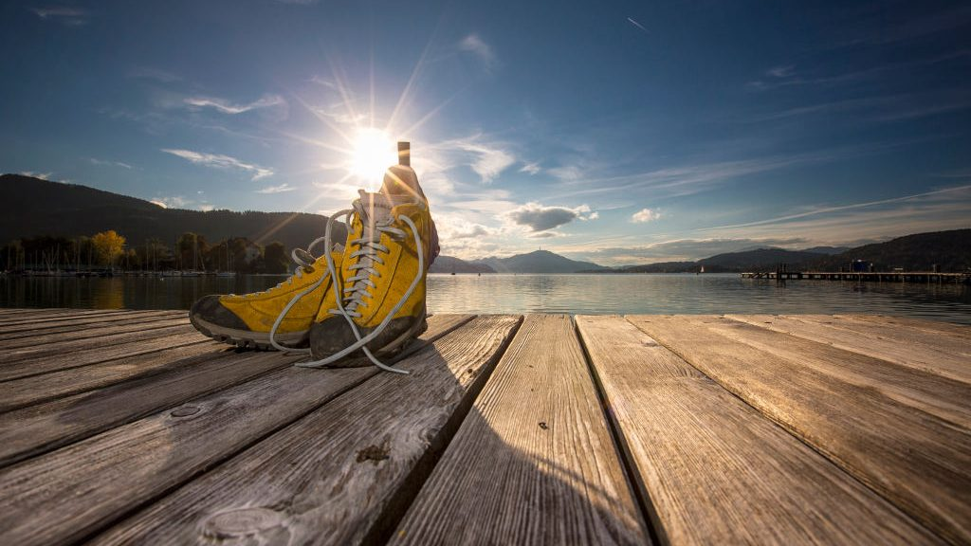
TRAIL ANGELS LTD
THE EXPERTS IN
DEVELOPMENT AND SUSTAINABLE MANAGEMENT
OF TRAILS
www.trail-angels.com
www.bookyourtrail.com

Slide 3
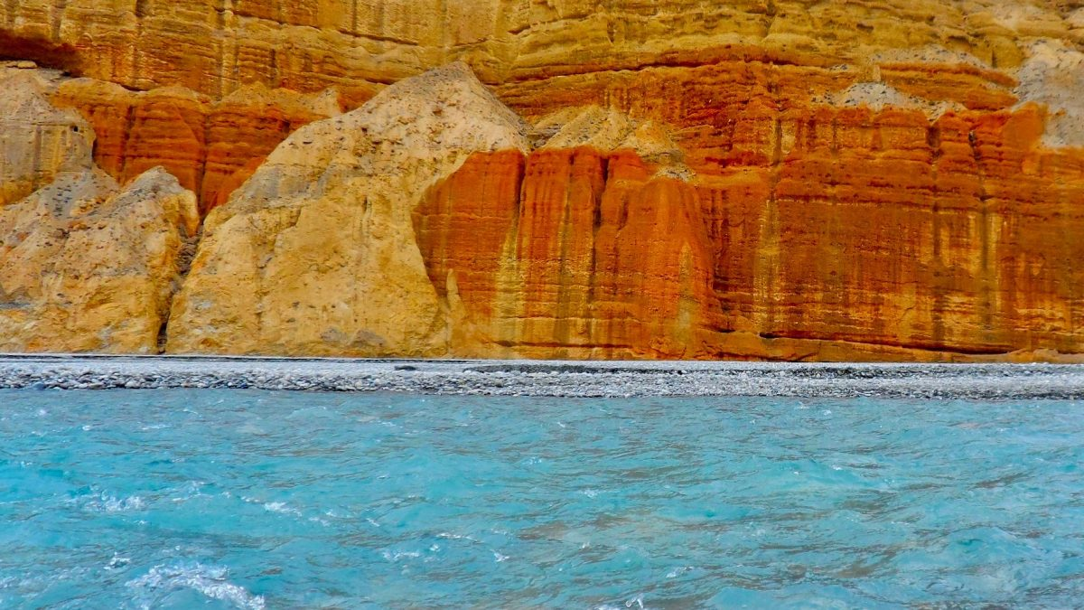


CONTENT
IMPACT
CAPABILITY
BUSINESS
MODEL
About the Trail Angels &
their expertise
About our
trail booking- &management system Bookyourtrail®
About the benefits
of Fair Trails®

Slide 4
1. CAPABILITY
ABOUT THE TRAIL ANGELS
WHO WE ARE
WHAT WE ARE DOING
AWARDS
REFERENCE PROJECTS
CAPABILITY

Slide 5

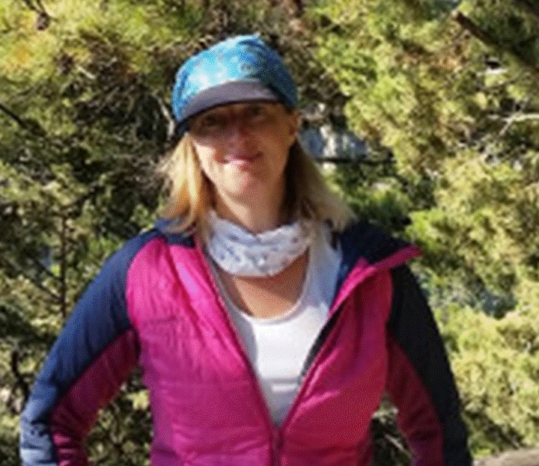
1. CAPABILITY
Trail Angels Ltd.
Based in Obervellach/Mölltal/Carinthia
Founded 9/15
Legally: Travel agency and tourism consulting
Staff: 9 (one in Nepal)
Cooperations: high profile network partners
Long term experience in: destination management; travel agency activities; university teaching; software development; business consultancy; sport management; outdoor activities; protected area management
GÜNTER MUSSNIG
NATHALIE REICHHOLD
WERNER MUSSNIG
FINANCIAL
EXECUTIVE
OPERATIVE
RUDI TRINKO
IT
SONJA THALER
BOOKING CENTER

Slide 6
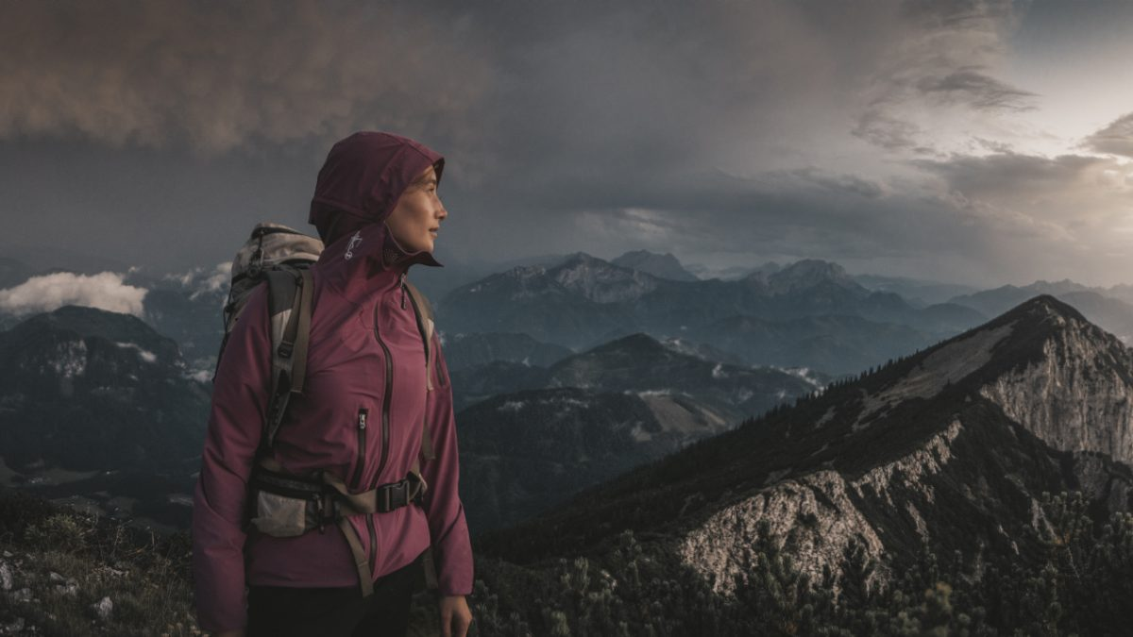
1. CAPABILITY
Main business activities:
Trail development
  All milestones from the idea till „ready for booking“
Trail booking management
  Running a capable trail info- & booking center, based on the unique trail booking & management-system Bookyourtrail.com®
Online marketing
Software development
  Steady progression of Bookyourtrail®
„Leading trails to values“

Slide 7
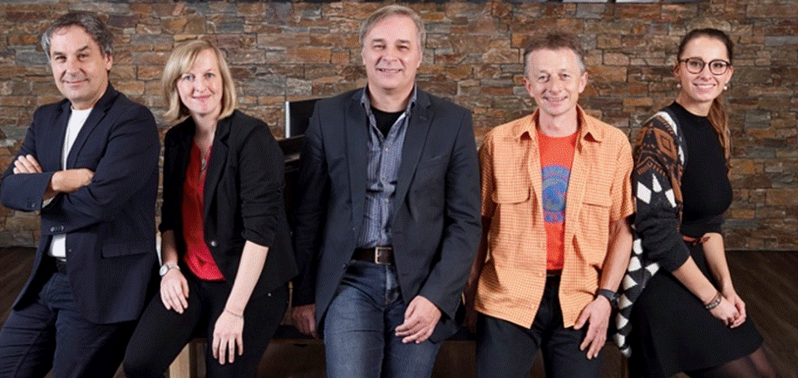
1. CAPABILITY
  Awards
  Austrian Economic Services (AWS): „Most innovative start up in rural areas“ 2016
  Austrian Development Agency /ADA): „Official Contribution to the International Year of Sustainable Tourism and Development“ 2017
  Nominees „Price for Research- & Innovation Carinthia“ 2016 & „Price for Sustainability Carinthia “ 2018
  National Geographic Traveller International „Best New Trail“ 2016 & „Best travel under the scope“ 2018
  National Geographic Germany „Top 7 Trail“ 2017
  Tour Natur Germany „Best long distance hike in Austria“ 2018

Slide 8


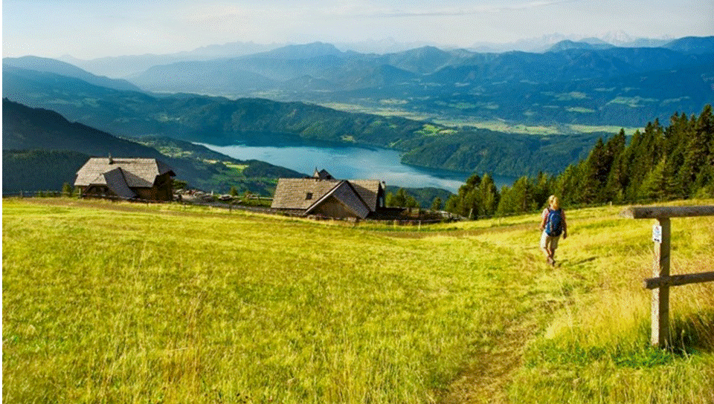




1. CAPABILITY
REFERENCES: ALPE ADRIA TRAIL
Long distance hike route from the glacier to the sea
Start: Grossglockner; Goal: Muggia (adriatic sea)
44 daily stages (750km) through Austria, Slovenia, Italy
1st Season: 2013; managed by three booking centers in Obervellach, Tarvisio, Bovec
Development (e.g. 2018): ca. 15.000 long distance hikers; annual revenue of € 8 Million; steady rise of numbers; clients from 27 nations; 25 travel agancies contracted.
Appr. 300 partnership accomodations contracted
Trail Angels: Official Trail Info- & Booking Center for Carinthia; product development; software license for booking center Slovenia.

Slide 9
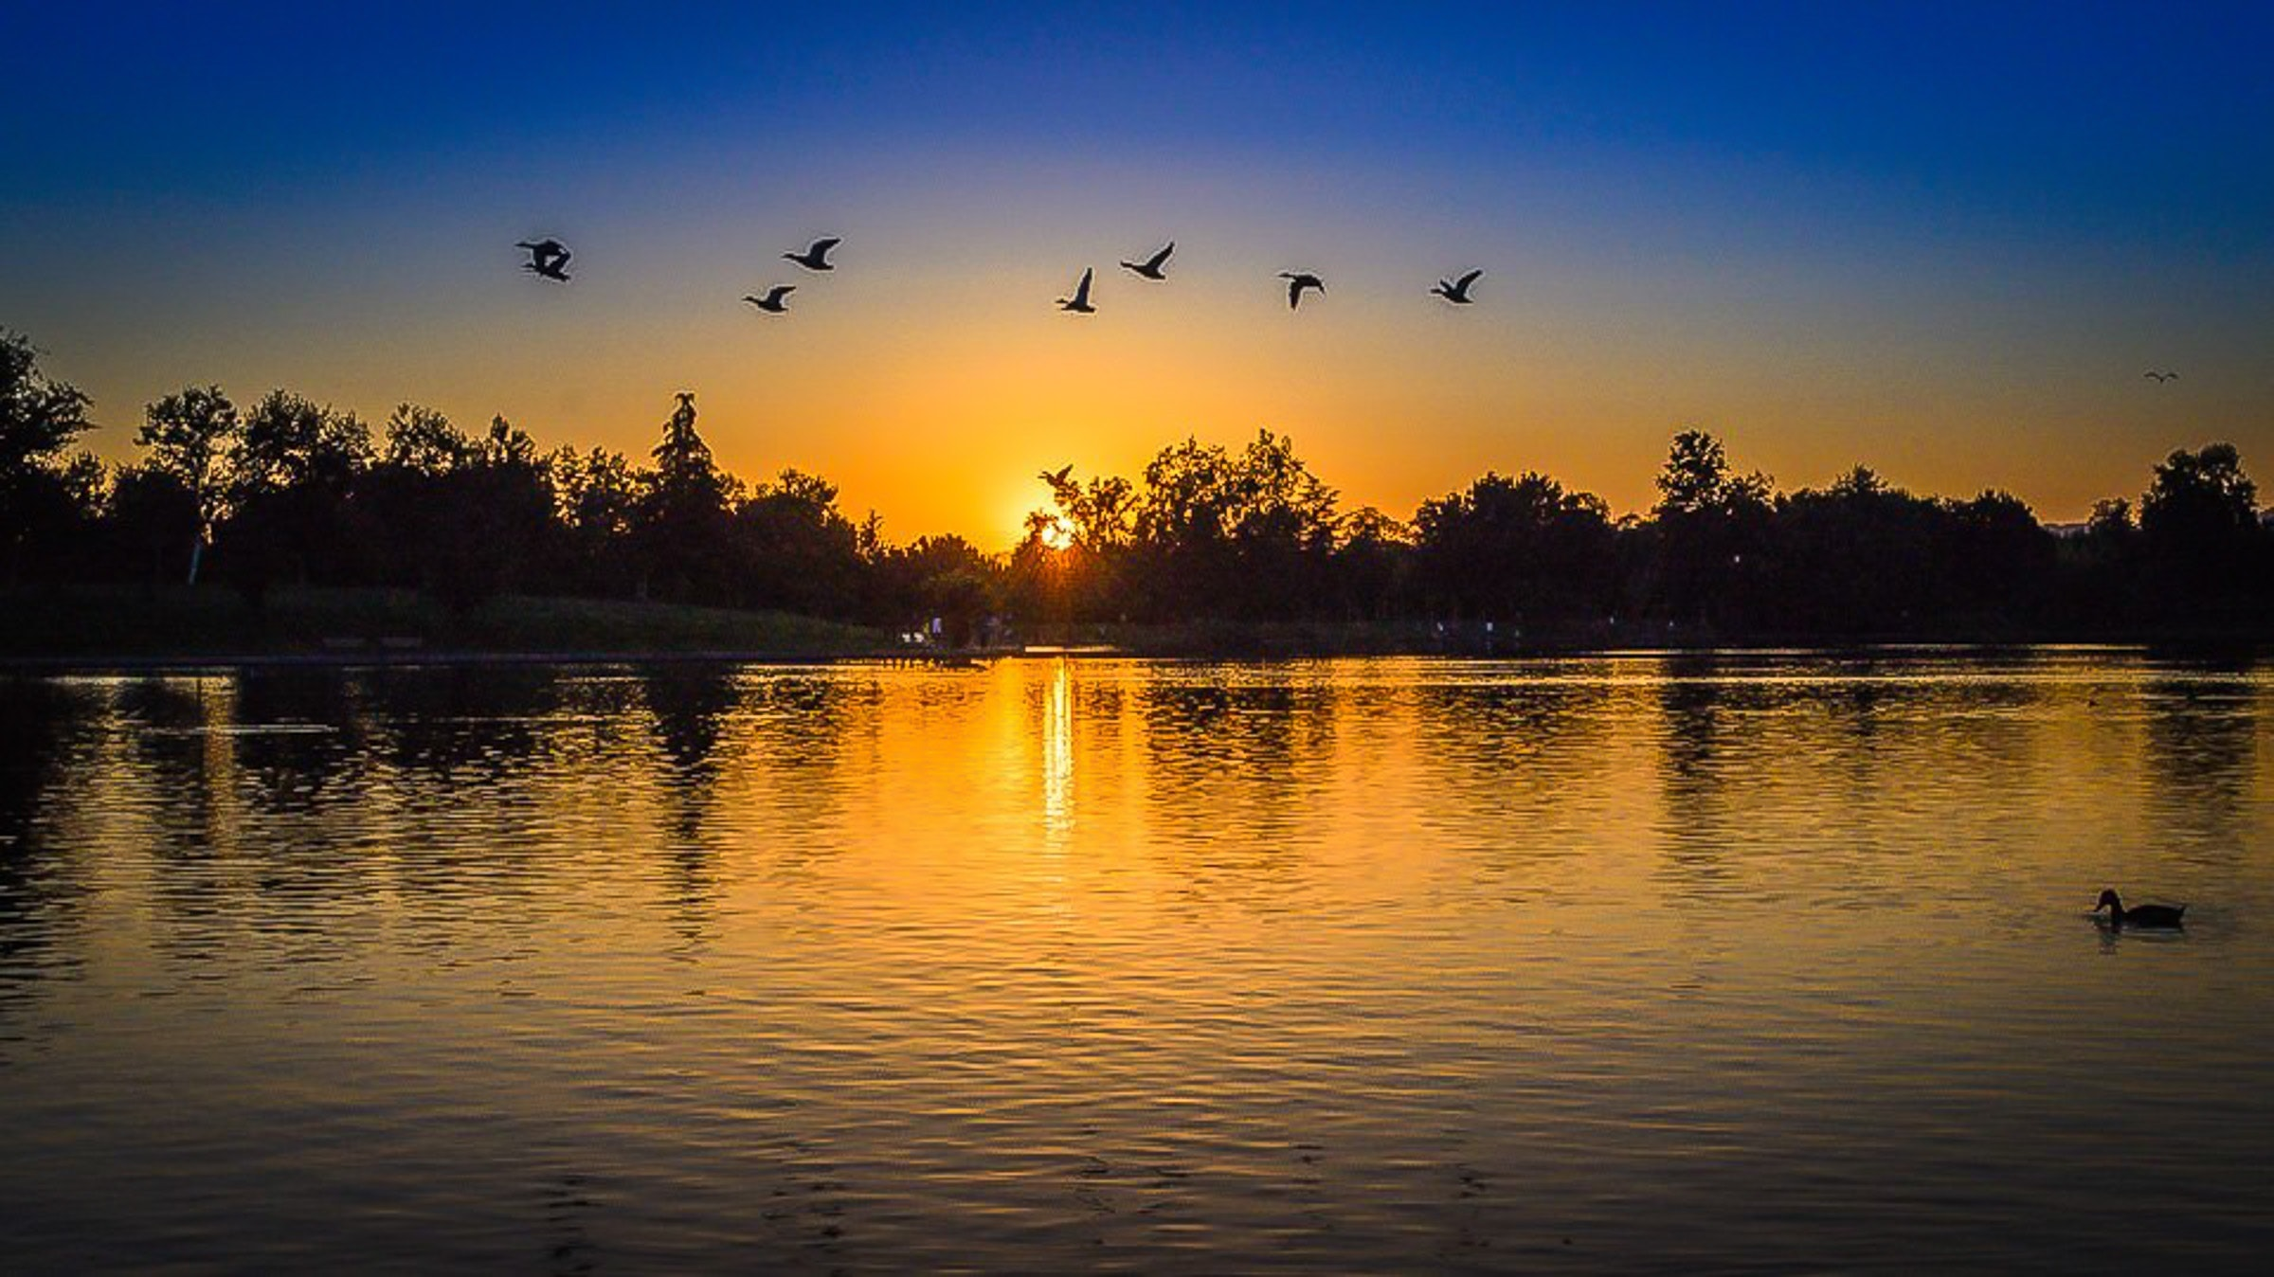


1. CAPABILITY
  REFERENCES:
  AMAZON OF EUROPE BIKE TRAIL
  Long distance cycling route
  Cofunded by the INTERREG Danube Transnational Programme (European Union)
  Initiated by the WWF for the development of a sustainable tourismus along the pristine river wilderness along Mura, Drava and Danube
  Start: Mureck (Austria); Goal: Mohasz (Hungary)
  Two routes with together 2.000km length; through Austria, Slovenia, Hungary, Croatia and Serbia
  Trail Angels: Partner & Work Package Leader „Product development“; set up of a bookable transnational bike route; set up of an „AOE Academy“

Slide 10

1. CAPABILITY
REFERENCES: FAIR TRAILS® HIMALAYAS
Set up of a business model and joint venture for the development of a sustainable and fair trekking tourism im Nepal, India and Bhutan
Cofunded by the Austrian Development Agency
    In Partnership with ENNOVENT
1st Fair Trail®: „Snow Leopard Trail“
    Supporting the protection of the Snow Leopard in cooperation with the Snow Leopard Conservancy
Further infos on Fair Trails® in chapter 3 „Impact“
Further trail projects (selected):
  In cooperation with national or regional tourism boards in several regions of Austria as well as in Bavaria, Slovenia, Italy

Slide 11
2. BUSINESS MODEL
ABOUT BOOKYOURTRAIL®
GOAL
APPROACH
OUTCOME
FUNCTIONALITY
BUSINESS
MODEL

Slide 12
2. BUSINESS MODEL
OUR GOAL IS A SUSTAINABLE MANAGEMENT TRAILS
(E.G. LONG DISTANCE HIKING OR BIKING ROUTES)
LIKE DESTINATIONS
„In everything you do, to focus on which will persist,
that´s sustainability!“

Slide 13


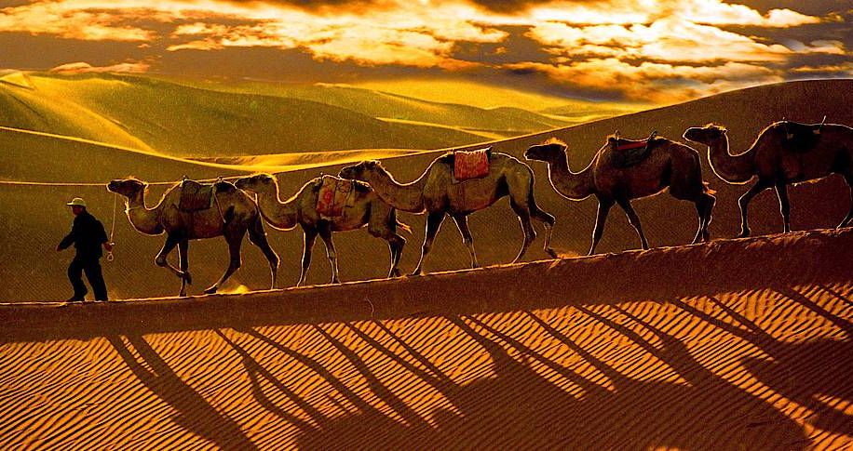
2. BUSINESS MODEL
Marketing (by National Tourism Boards)
Website
(incl.Bookability)
THE CLIENT
„Who is he/she?
THE STORY
„Awakening the longing“
ACCESS
&
CONVENIENCE
THE PRODUCT
„Making the dream
come true“
e.g. SILK ROAD TRAIL
ADVENTURE TRAVEL IN THE CENTRAL ASIA REGION
Booking Center (in coop. with regional travel agencies)
Trail Management System (multi client booking service)

Slide 14
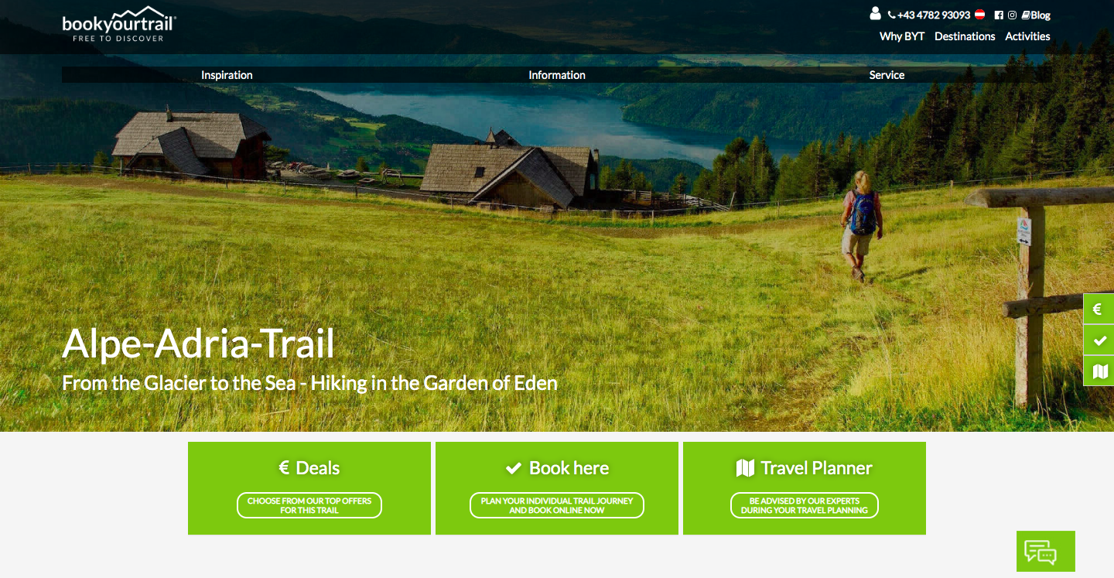
2. BUSINESS MODEL
IMPLEMENTATION: TRAIL BOOKING & MANAGEMENT SYSTEM
www.bookyourtrail.com
The world´s first and still unique trail booking- & management system!

Slide 15
2. BUSINESS MODEL
IMPLEMENTATION: TRAIL BOOKING & MANAGEMENT SYSTEM
www.bookyourtrail.com is offering:
Booking system:
Unique functionality for clients, including various points of sale:
  Dynamic packaging
  Online travel planer upgraded by booking center support
  Instant online booking with real time availability check
Management system:
High profile, multi clients capable trail management system
Full integration of booking managements along the customer´s journey
Efficient service provider management (e.g. tour operators, accomodations etc.)
Full transparency and high end compliance standards based on digital integration
Optimized for the adjustment of scalability and applicability

Slide 16
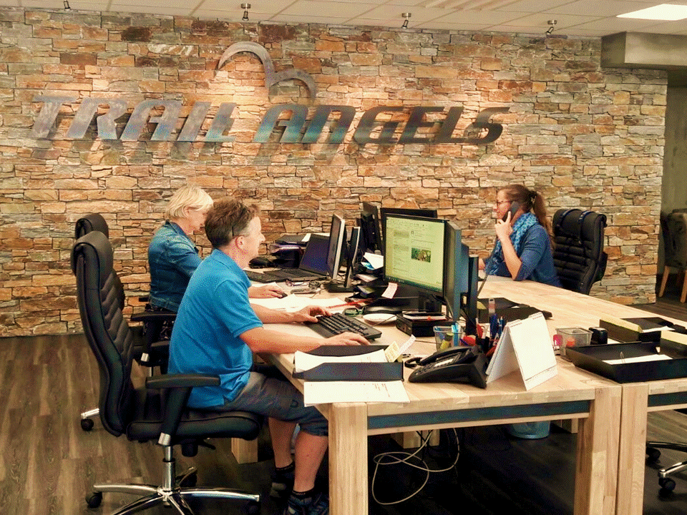
2. BUSINESS MODEL
IMPLEMENTATION: TRAIL INFO- & BOOKING CENTER:
Experienced and professional Team
Tasks
  Inbound / Outbound Travel Agency
  Inquiry & Booking-Management (B2C; B2B; Reselling)
    Enhanced 7/12 services (Online Chat; Trail Hot Line)
  Service Provider Management
  Evaluating, reporting, qualification, progression, etc.

Slide 17
3. IMPACT
ABOUT FAIR TRAILS®
GOAL
APPROACH
IMPACTS
IMPACT

Slide 18

3. IMPACT
OUR GOAL IS
- BASED ON THE UNIQUE CAPABILITIES OF BOOKYOURTRAIL® –
THE IMPLEMENTION OF A FAIR TRAILS® BUSINESS MODEL FOR THE SUSTAINABLE DEVELOPMENT OF RURAL AREAS IN REMOTE
(LONG DISTANCE) MARKETS

Slide 19

3. IMPACT
THE FIVE PILLARS OF FAIR TRAILS®
FOCUS ON LESS DEVELOPED REGIONS
  First priority: Implementing trails in less developed areas
  Second priority: Transforming tourism into more sustainablity in developed areas
2. TOPIC TRAILS
  Upgrading every Fair Trail® with an special topic (e.g. wildlife, culture)
  Including an impact fee for funding projects (related to topic) along the trail
3. FAIR TRAILS BUSINESS MODELL
  Transparency & fairness (e.g. fair wages, working conditions & commissions)
  Participatory and sustainablity (integration of local people in project streering)
  Building up knowledge and skills (Fair Trails® Academy)

Slide 20
3. IMPACT
THE FIVE PILLARS OF FAIR TRAILS®
FAIR TRAILS® CRITERIA
  Implementing a certification process, based on a setting of international (e.g. travel agencies) and regional (e.g. tour operators, accomodations) criterias
  Going one step further: progression of the criteria setting in cooperation with all (regional) stake holders
5. INNOVATIVE ACCESS TO THE MARKETS
  Using the benefits of Bookyourtrail® platform
  Building up a B2B Fair Trails® network (LOI´s of appr. 25 B2B partners)
  Building up a Fair Trails® community

Slide 21
DISCUSSION
AND NOW, LET´S DISCUSS ☺

Slide 22
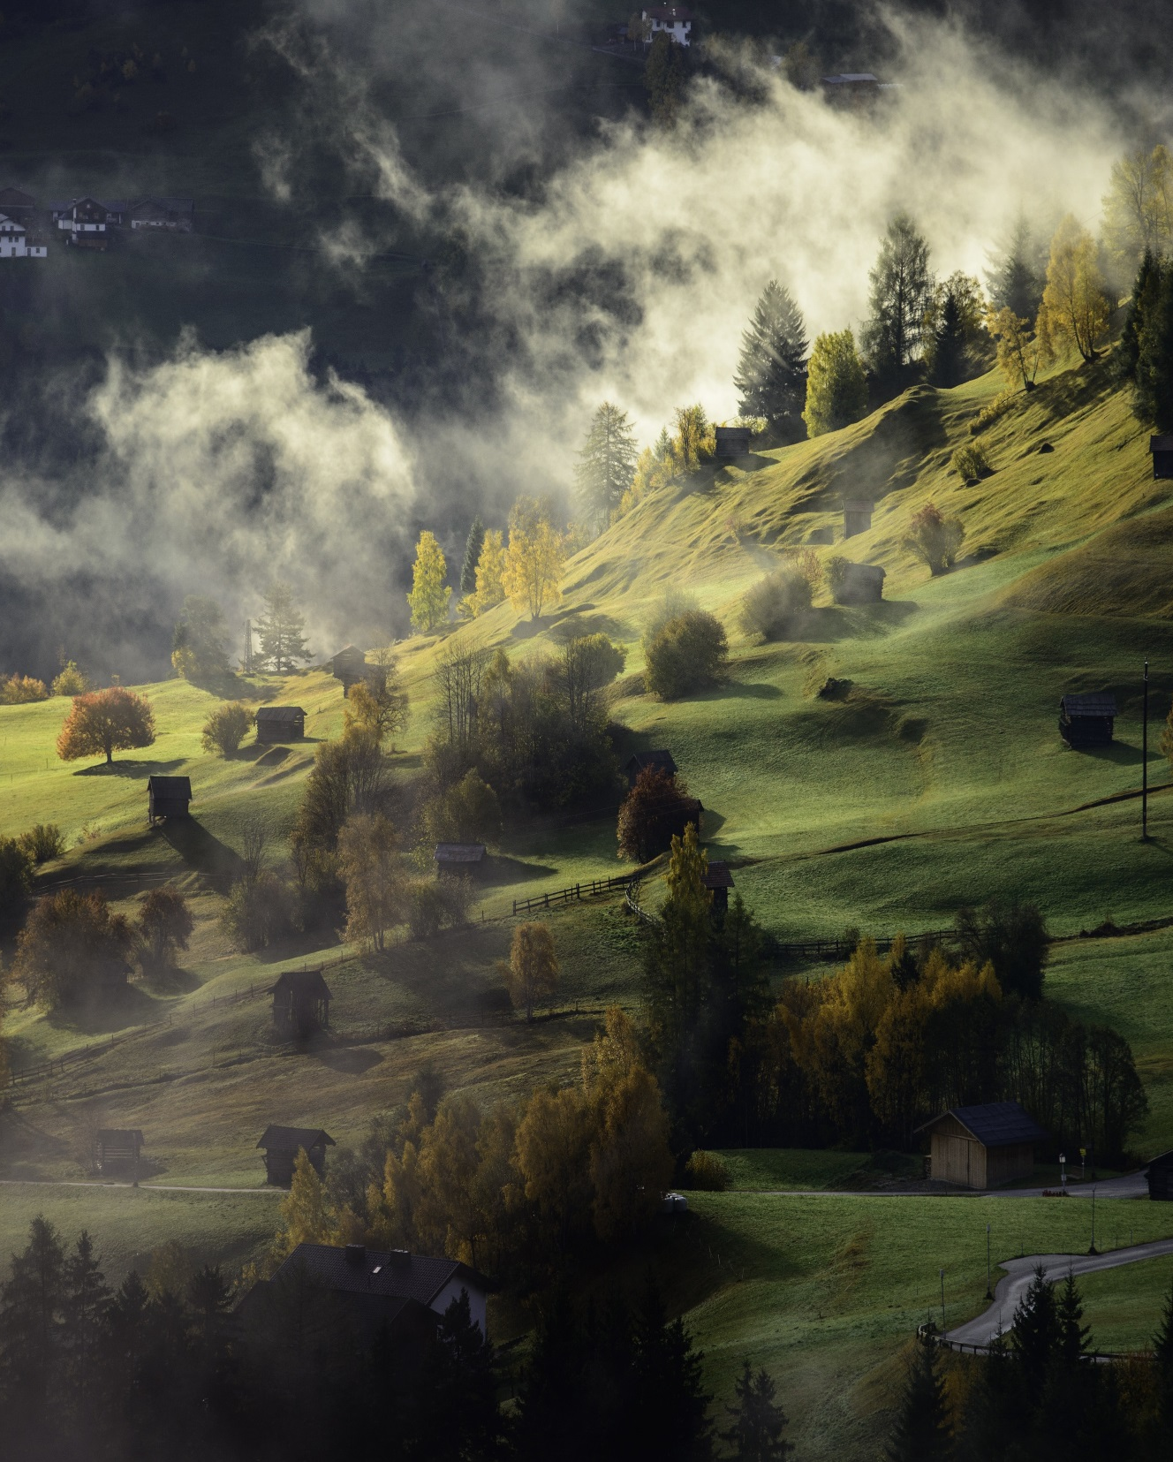




It´s a Trail´s World
Imprint
Media owner, publisher & responsible for the content:
Trail Angels Gmbh;
Copyright:
The entire content of this presentation is the intellectual property of the authors. Their use (or parts thereof) requires written permission.
Obervellach, June 2019
Get involved!
Trail Angels GmbH
A-9821 Obervellach 15
T: +43 (0) 4782 93093
M: office@trail-angels.com
W: www.trail-angels.com
UID: ATU70185505
www.bookyourtrail.com
Das weltweit erste Trail Online Informations-, Buchungs- & Managementsystem

