Slide 1



International Academic Collaboration between Austria and Central Asia as a Strategy for Sustainable Development
Best Practice Erasmus Mundus Project
“gSmart – Spatial ICT Infrastructures for Smart Places”
Gernot Paulus and Adrijana Car
Geoinformation @ Carinthia University of Applied Sciences (CUAS)
{paulus@cuas.at | car@cuas.at}
2. Forum Anthropozän, 20.-22.06.2019

Slide 2
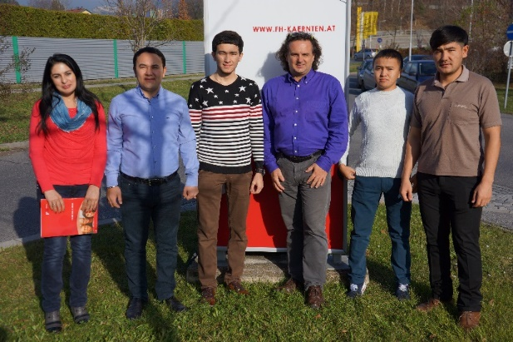
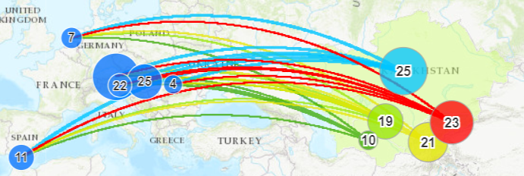
Erasmuns Mundus gSmart ‐ Spatial ICT Infrastructures for Smart Places at a glance
Erasmus Mundus funded mobility scholarship project
for Central Asian students and staff
  13 Central Asian Universities & 6 European Universities
  Duration: 2013 – 2017
  Total Funding: € 2,162,375
106 reported scholarships:
  Bachelor to PhD and Post‐Doc levels, and Faculty
  Short to degree‐seeking exchange visits
Explore gSMART at https://tinyurl.com/gsmart-EM

Slide 3
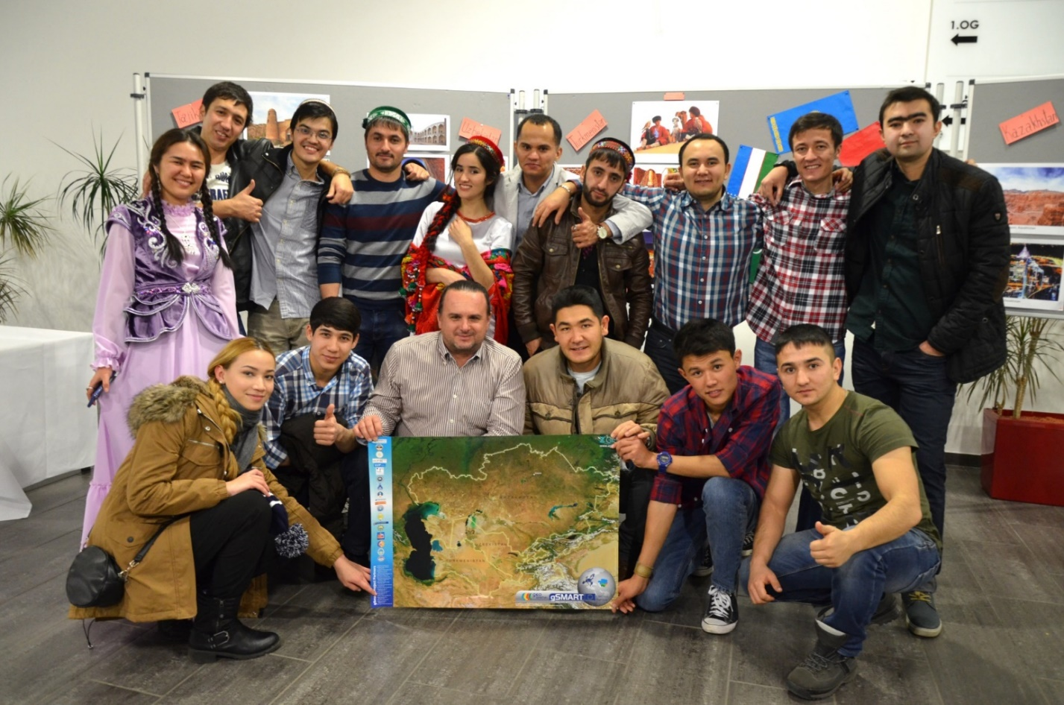
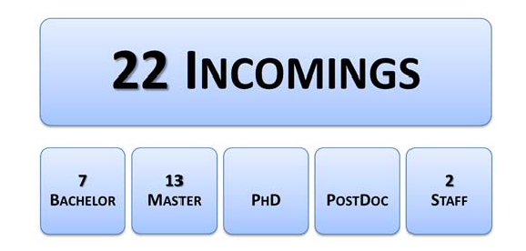
gSMART@ CUAS
MSc Spatial Information Management
1st Erasmus Mundus Project Participation for CUAS
Central Asian Evening @ CUAS

Slide 4
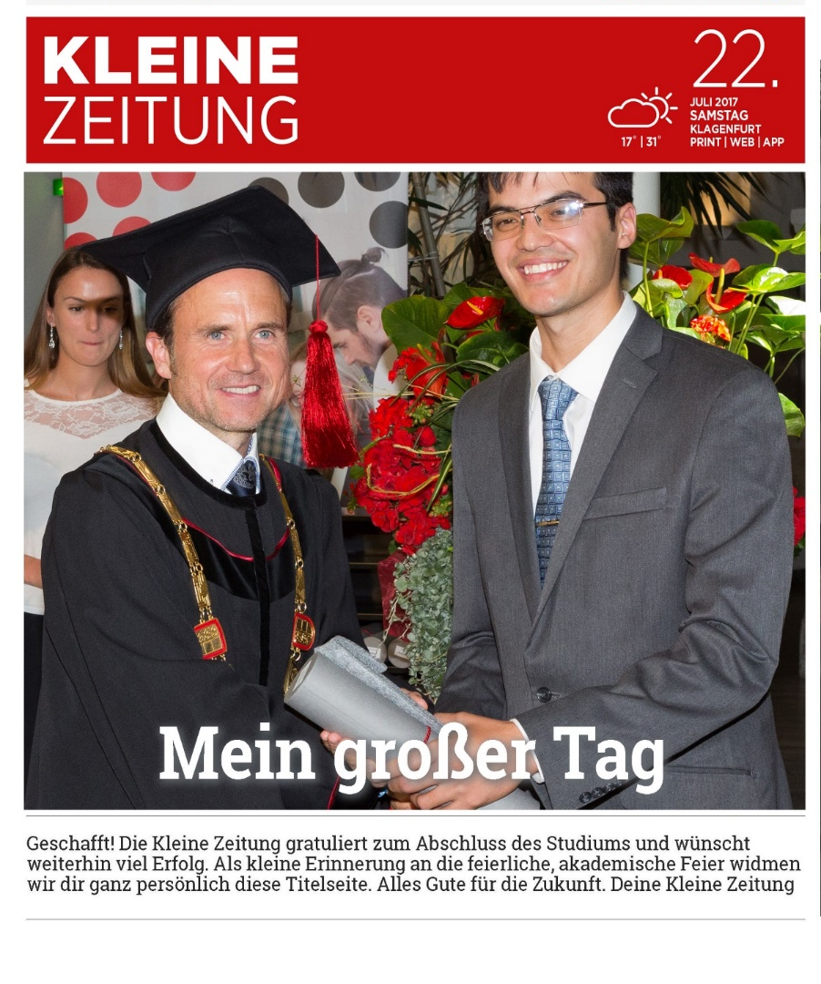
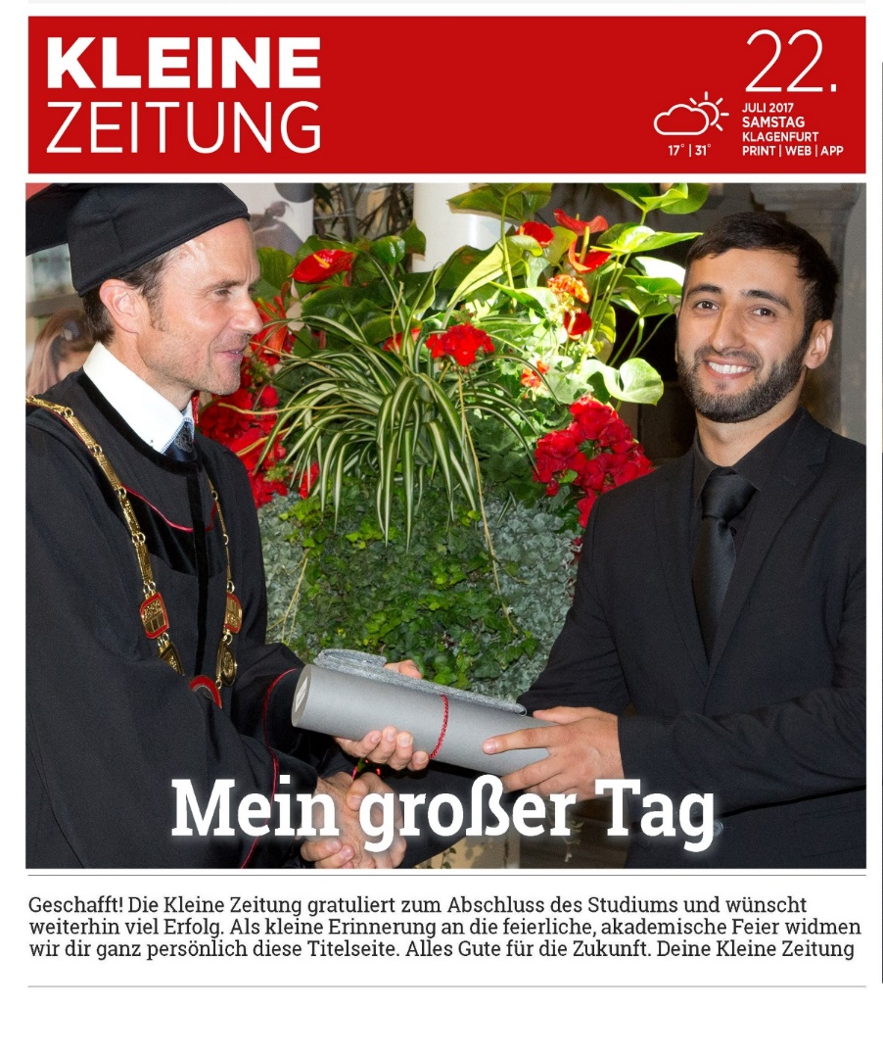
gSMART Graduates @ CUAS
Rustam Mivyliev
Tohir Sabzaliev

Slide 5
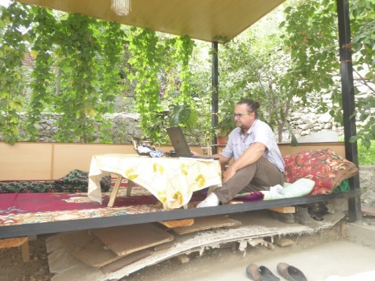
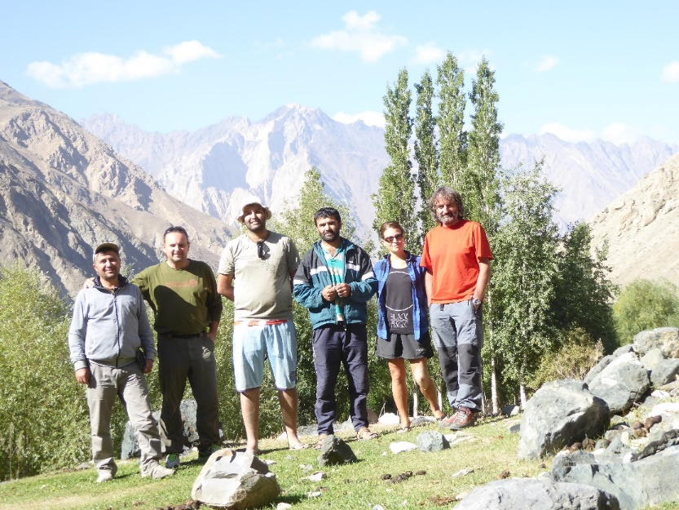
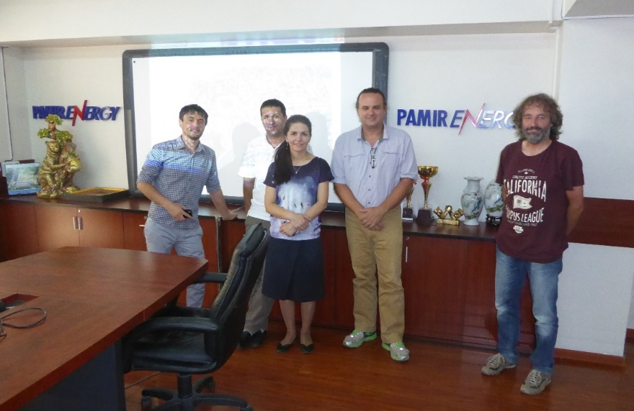
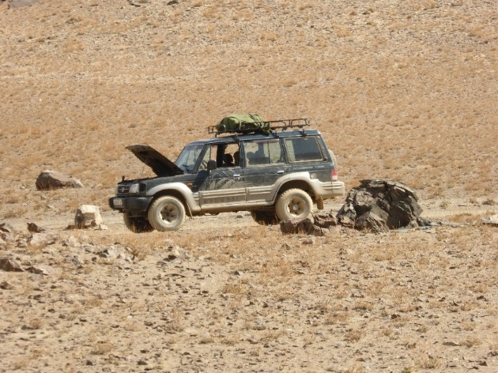
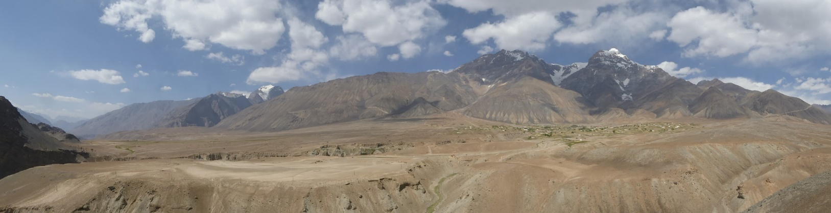
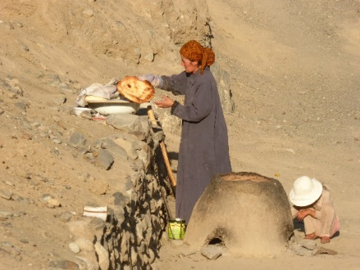
„Brain Gain – not Brain Drain“
Staff Mobility @ Khorog State University (Tajikistan)
Austrian-Tajik Field Expedition 2016
Expert Meeting Pamir Energy

Slide 6
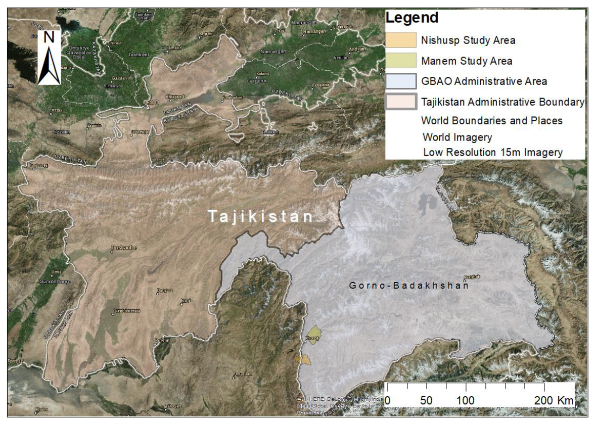
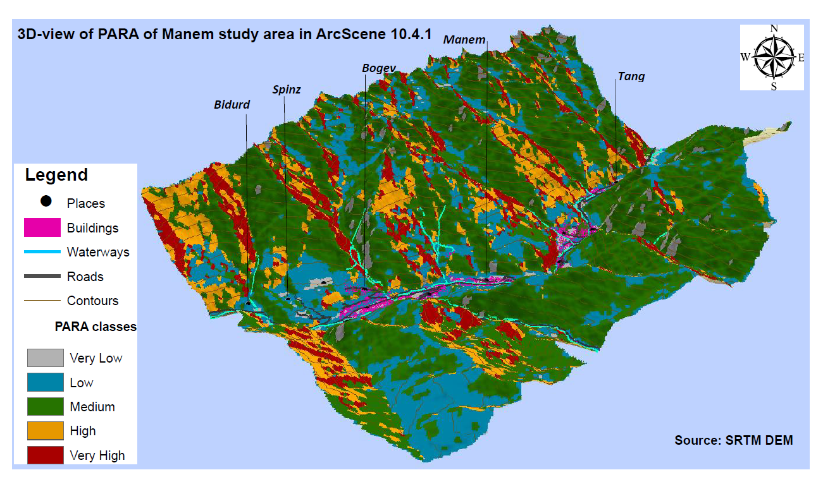
„Brain Gain – not Brain Drain“
Support of Master Thesis research in home region – Natural Hazard Risk Management
Sabrina Vatanshoeva: Avalanche Risk Assessment in the Pamir, Tajikistan
supported by University of Central Asia - Mountain Society Research Institute

Slide 7
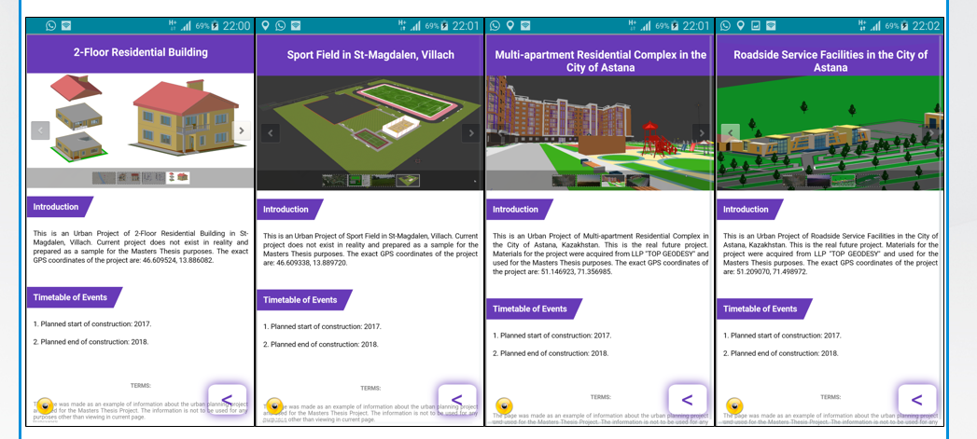
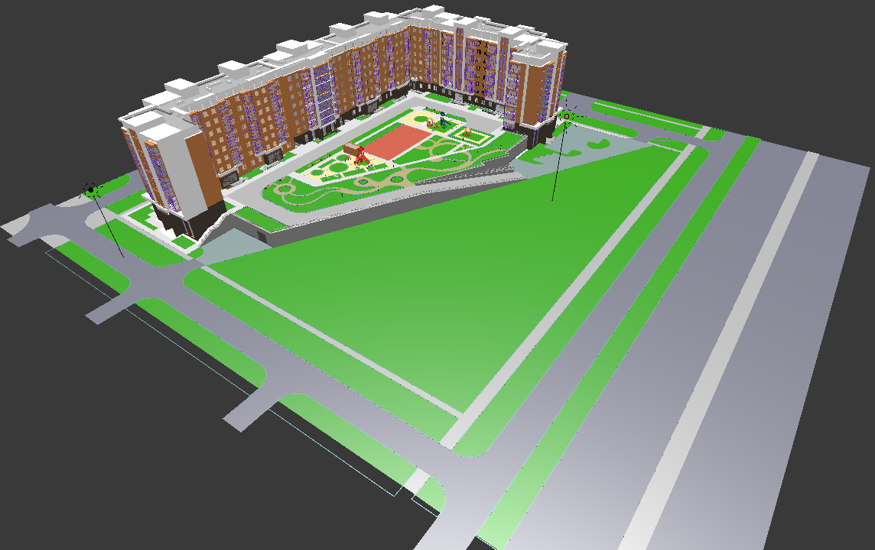
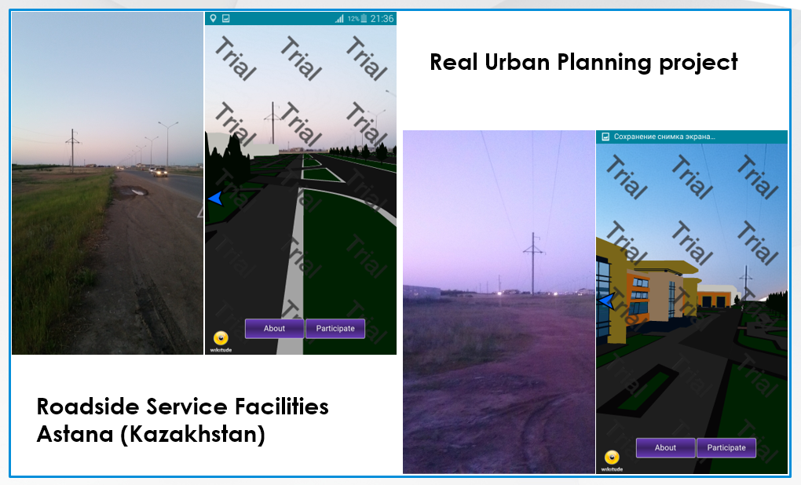
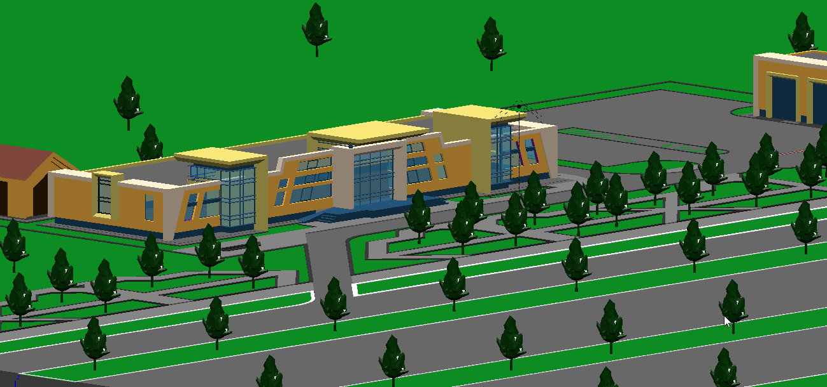
„Brain Gain – not Brain Drain“
Support of Master Thesis Research in home region – Urban Planning & Smart Technologies
Yelbek Utepov: Developing a Geo-located Augmented Reality Mobile Application for
Participatory Urban Planning
3D
Models

Slide 8
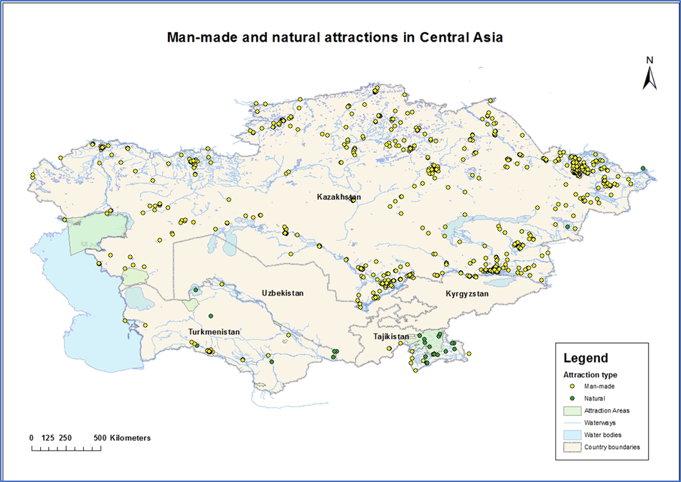
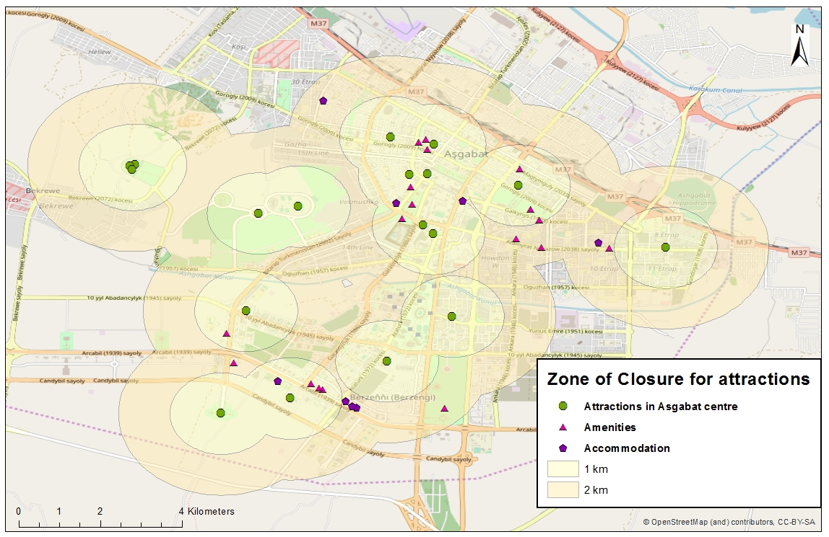
„Brain Gain – not Brain Drain“
Support of Master Thesis Research in home region – GIS in Tourism
Tohir Sabzaliev, Rustam Mivyliev, Nurperi Nuralieva, Akmaral Tokbergenova:
GIS-based Modelling and Analysis of Tourism Infrastructure in Central Asia (4A’s and Tourism Product)

Slide 9
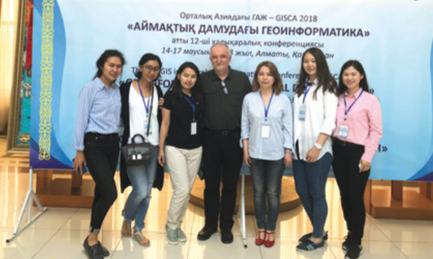
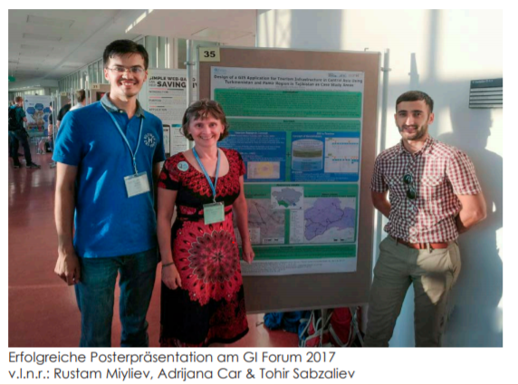
„Brain Gain – not Brain Drain“
Striving for academic excellence in home region and internationally
GIS in Central Asia Conference – GISCA 2014-2018 || GI_Forum 2017-2018
Car, A., R. Miyliyev, T. Sabzaliev and G. Paulus (2018). "Design of a Geodatabase for tourism Infrastructure in Central Asia." International Journal of Geoinformatics 14(1): 43-52.

Slide 10
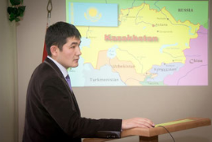
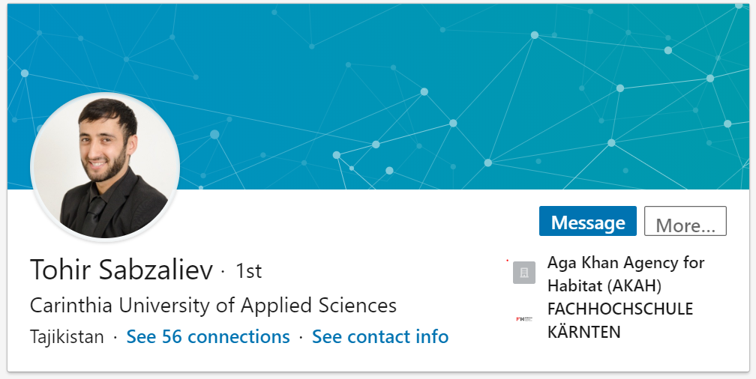
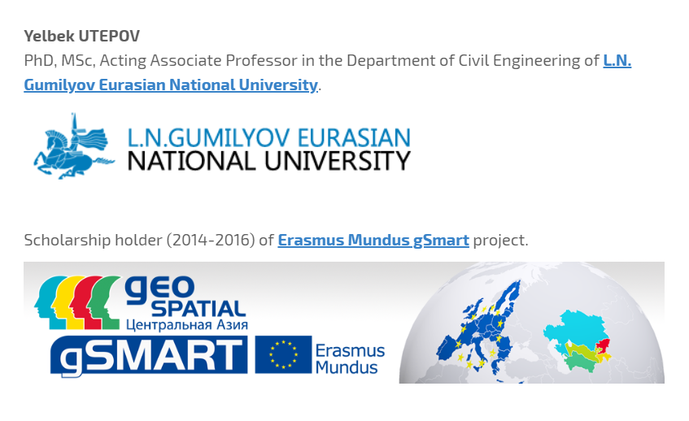
„Brain Gain – not Brain Drain“
Alumni back home…
Astana, Kazakhstan
https://yelbekutepov.jimdo.com/
Spatial Data Infrstructure Suervisor

